Slide 1
Algorithmic choice relocates power
BLUESKY RQs + DATA
In data collection phase…
FEB 2026

Slide 2
System framing: pluggable services, new chokepoints
Takeaway: modular services relocate concentration.
viewer
discovery surfaces
feed generators
provider hosting
exposure outcomes
labelers
Discovery surfaces and provider hosting are key chekepoints.
FEB 2026

Slide 3

Bluesky UI: feed marketplace (/feeds)
Takeaway: feeds are discoverable + selectable algorithmic timelines.
A. /feeds directory
C
A
Search feeds
B
B. Feed cards
Creator + likes
C. Trending widget
Defaults matter
Discovery risk
FEB 2026

Slide 4
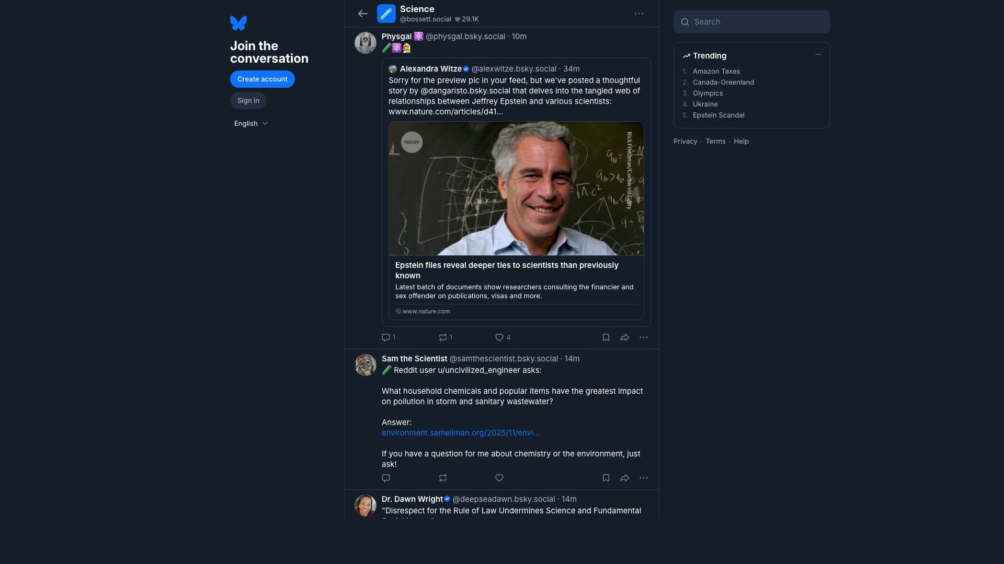
Bluesky UI: what a feed looks like
Takeaway: a feed page renders an algorithm into a timeline of posts.
A. Feed name
A
Demand signals
B
B. Timeline output
Exposure decisions
C. Post actions
C
Why we measure
Manipulation risk
FEB 2026

Slide 5

Bluesky UI: starter packs (onboarding bundles)
Takeaway: starter packs bundle people (and sometimes feeds) for fast onboarding.
A. Pack title
A
Curated list
B
B. Join button
1-click onboarding
C
C. People cards
Curation questions
Measure exposure
FEB 2026

Slide 6
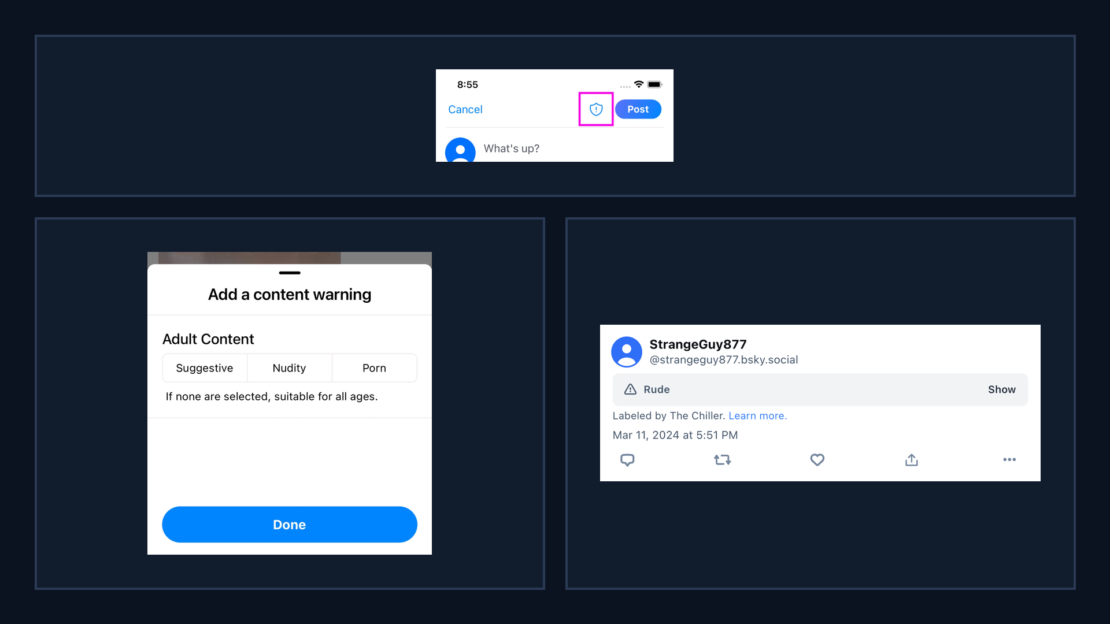
Bluesky UI: labeling surfaces
Takeaway: labels are user-facing controls that shape what gets shown or filtered.
A. Self-label button
A
Composer surface
B. Content warning picker
B
C
Adult Content options
C. Labeled post banner
Attribution to labeler
Why it matters: filtering + exposure

Slide 7
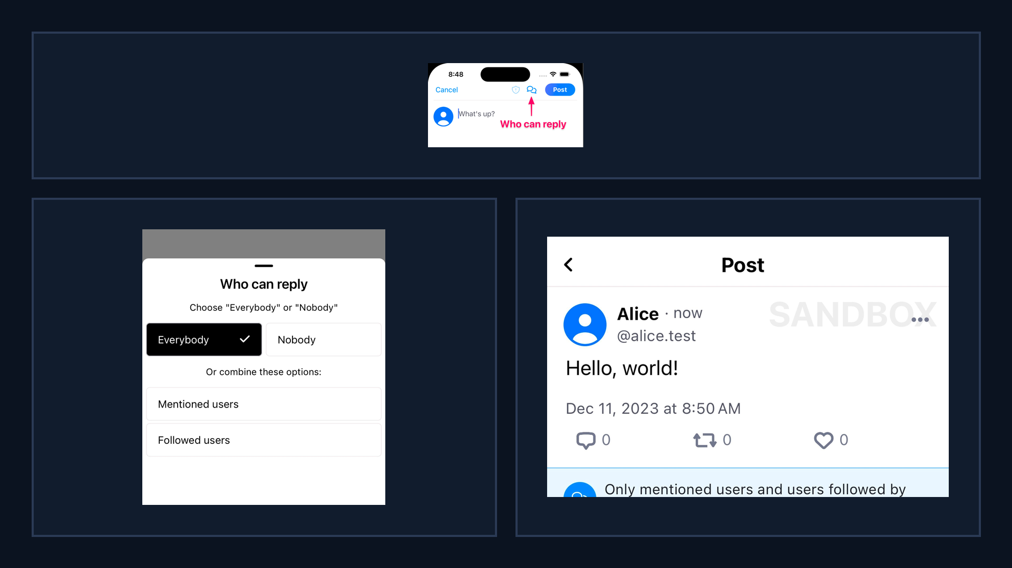
Bluesky UI: reply controls
Takeaway: reply controls gate interaction, changing who can respond and what feedback loops form.
A. Reply controls button
A
Composer setting
B. Who can reply picker
B
C
Audience gating
C. Post notice
Visible constraint
Why it matters: interaction graphs

Slide 8
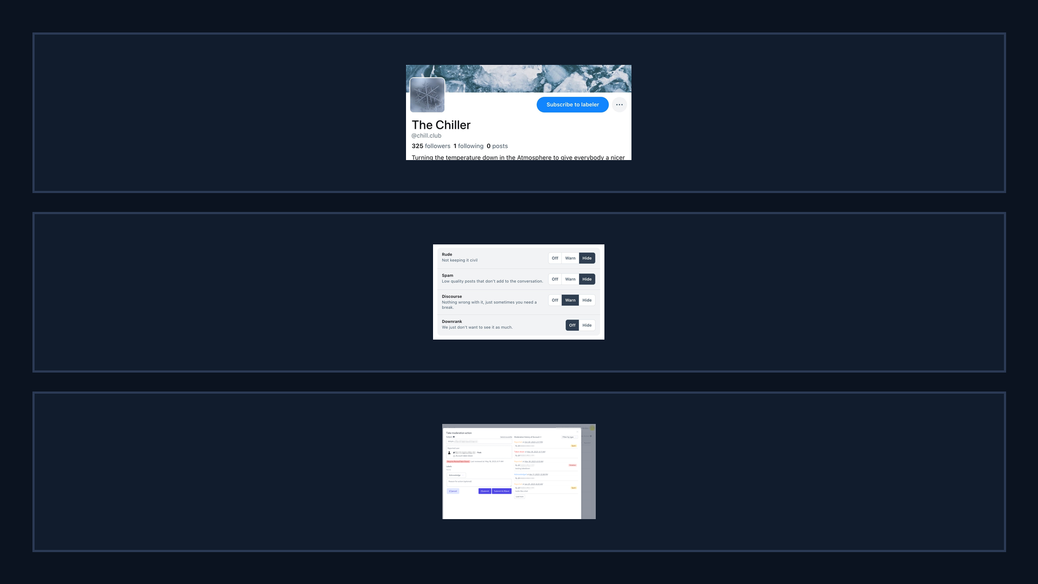
Bluesky UI: labelers + moderation tools
Takeaway: moderation is modular, users can subscribe to labelers and tune label handling.
A. Subscribe to labeler
A
Third-party policies
B. Per-label controls
B
Off / Warn / Hide
C. Ozone moderation UI
C
Operational tooling
Why it matters: power shifts

Slide 9
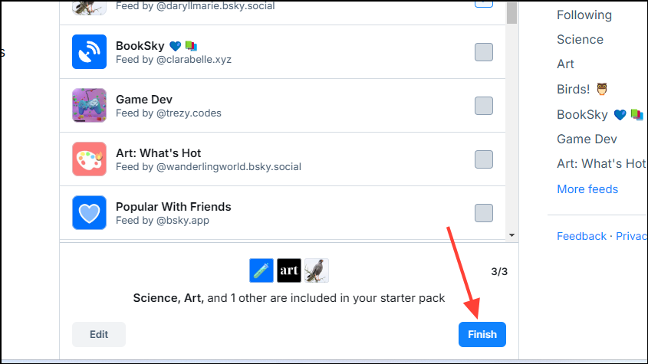
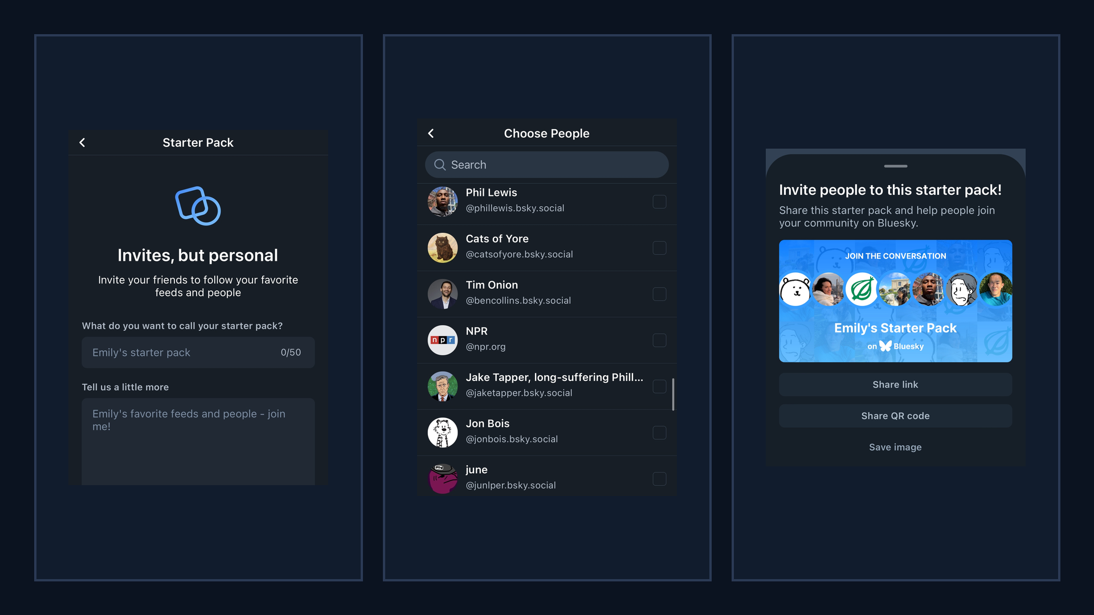
Bluesky UI: starter packs flow
Takeaway: starter packs bundle people (and context) into a single shareable onboarding object.
A. Create starter pack
A
B
C
Name + description
B. Choose people
Curation choices
C. Share pack
Link / QR / image
Why it matters: bundled exposure

Slide 10
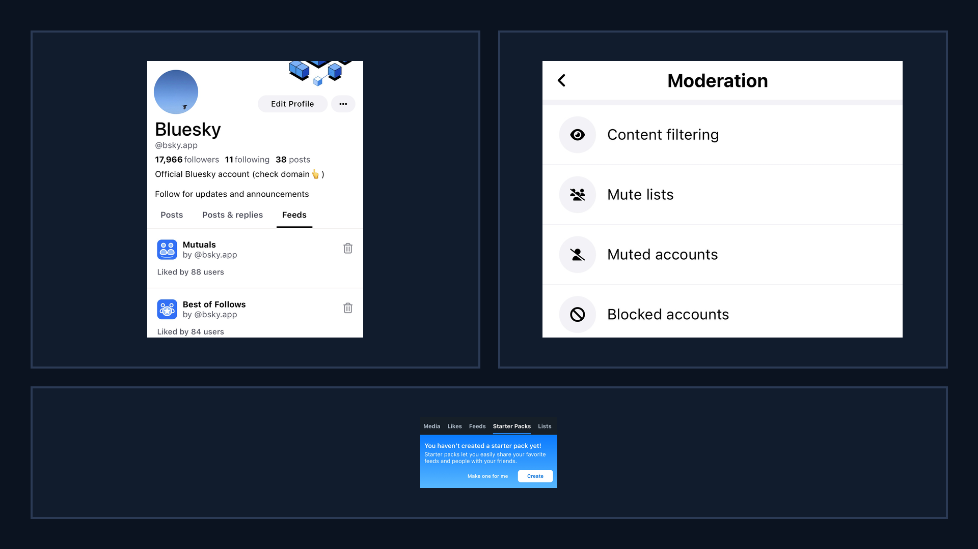
Bluesky UI: discovery surfaces
Takeaway: discovery is shaped by navigation, defaults, and safety settings surfaced in the UI.
A. Custom feeds tab
A
B
Algorithm marketplace
B. Moderation menu
Filtering settings
C. Starter packs tab
Onboarding surface
C
Why it matters: defaults steer

Slide 11
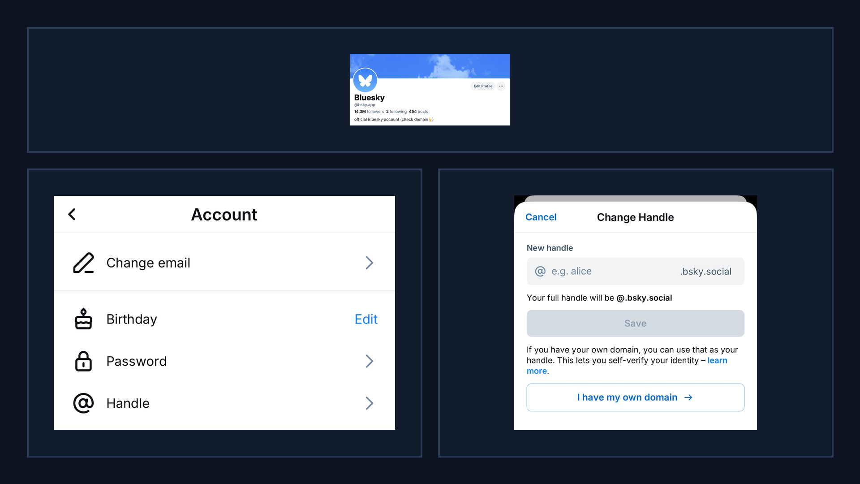
Bluesky UI: domain handles (surface → settings)
A. Domain handle profile
A
Trust signal
B. Settings: handle
B
C
Entry point
C. Use own domain
Verification flow
Why it matters: credibility

Slide 12
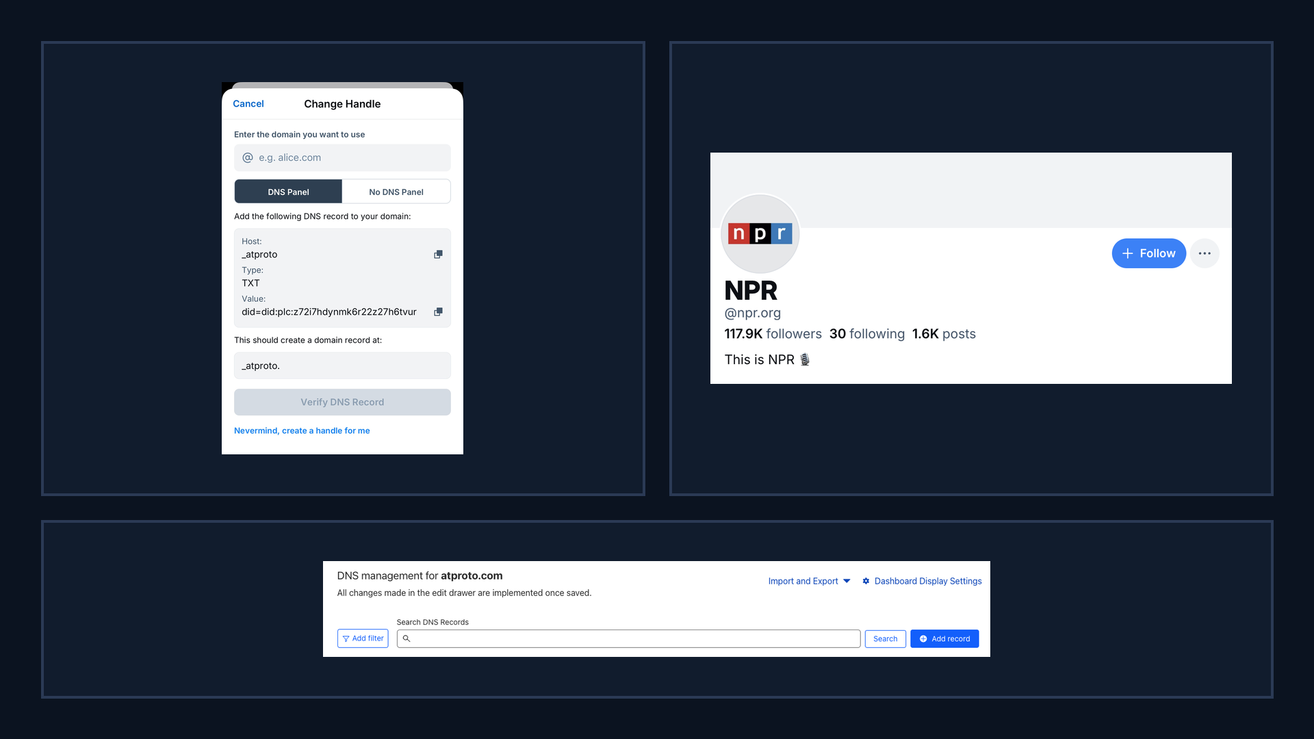
Bluesky UI: domain verification + examples
BLUESKY RQs + DATA
verification relies on external DNS tooling, creating measurable and potentially gameable steps.
A. DNS TXT record
A
B
Proof-of-control
B. Domain handle example
@npr.org
C. DNS management UI
External dependency
C
Why it matters: measurable steps

Slide 13
Research questions (R1-R5)
01
05
02
03
04
security and privacy scope.
R1 Discovery chokepoints? governance.
R5 Future experiment: gaming plus privacy attacks. extra guardrails.
R2 Provider buckets dominate? reliability.
R3 Same winners across feeds? manipulation.
R4 Labels vary by viewer? safety.

Slide 14
RQ1
In Bluesky, which is ‘pluggable,’ or decentralized. does onboarding/discovery behave like a centralized platform anyway? Concretely: how concentrated are starter packs and other discovery surfaces, and how much leverage do a few feed providers get over what new users see?
starterpacks.csv
starterpack_feeds.csv
discovery_feed_inclusions.csv
feed_generators_index.csv
popular_feeds.csv

Slide 15
RQ1 Sample Rows (real data): discovery + onboarding inputs
starterpacks (starterpacks.csv)
starterpack_feeds (starterpack_feeds.csv)
starterpack_id | creator_did | name
3legy77zxsq2z | did:plc:26pjh...h5xb | Pawn Addicted's Starter...
3lbvimzzllz2n | did:plc:2flxu...5txp | Great Friends - Definit...
3lbvjglqfew2x | did:plc:2flxu...5txp | More Great Friends of Y...
3lbxesvv7wi2t | did:plc:2flxu...5txp | New friends to follow. ...
starterpack_id | slot | feed_id
3lr2lbcjrd623 | 0 | art-new
3ldln2v2kdg2k | 0 | verified-news
3ljlk4272z42a | 0 | aaac76qrfism2
3ljlk4272z42a | 1 | iowa
discovery_feed_inclusions (discovery_feed_inclusions.csv)
feed_id | inclusion_count | inclusion_rank
with-friends | 148 | 1
bsky-team | 145 | 2
hot-classic | 143 | 3
aaabrbjcg4hmk | 21 | 4

Slide 16
RQ1 Sample Rows (real data): provider and popularity context
feed_generators_index (feed_generators_index.csv)
popular_feeds (popular_feeds.csv)
feed_id | provider_bucket | creator_did
18d45e8582d9d85 | www.bluefeed.app | did:plc:27vo2...iw3h
aaaarwrz4nc7a | skyfeed.me | did:plc:27vo2...iw3h
aaab3telfmiho | skyfeed.me | did:plc:27vo2...iw3h
aaabdxowr3y2k | skyfeed.me | did:plc:27vo2...iw3h
feed_id | popularity_rank | collected_at
whats-hot | 1 | 2026-02-06
with-friends | 2 | 2026-02-06
mutuals | 3 | 2026-02-06
for-science | 4 | 2026-02-06

Slide 17
RQ2
Across feeds that people commonly discover/use, does exposure concentrate among fewer creators, do the same creators win everywhere, and do large accounts get boosted more than in long-tail feeds?
feed_panel.csv
feed_items.csv
posts.csv
authors.csv

Slide 18
RQ2 Sample Rows (real data): feed selection and observed ranking
feed_panel (feed_panel.csv)
feed_items (feed_items.csv.gz)
feed_id | feed_group | provider_bucket
aaagt6amuur5e | discovery_surfaced | skyfeed.me
aaai4f7awwzkc | discovery_surfaced | skyfeed.me
aaabrbjcg4hmk | discovery_surfaced | api.graze.social
bsky-team | discovery_surfaced | discover.bsky.app
feed_id | rank | author_handle
aaagt6amuur5e | 1 | onecuriousoul.b...
aaagt6amuur5e | 2 | danielleforrest...
aaagt6amuur5e | 3 | joharraharper.b...
aaagt6amuur5e | 4 | alexcahemma.bsk...

Slide 19
RQ2 Sample Rows (real data): post engagement and author size
posts (posts.csv.gz)
authors (authors.csv.gz)
post_id | author_handle | like_count
3me5fvdklx22s | climbingbird.bs... | 53
3me2tlvg6u22d | judithmonroe.bs... | 3845
3me4h47okq22j | bakerart.bsky.s... | 142
3me55z4anic2n | buriedbybooks.b... | 278
handle | followers_count | posts_count
climbingbird.bsky... | 329 | 1225
judithmonroe.bsky... | 2915 | 1136
bakerart.bsky.social | 14267 | 2225
buriedbybooks.bsk... | 2871 | 7301

Slide 20
RQ3
What attacks are feasible when (a) feed generators are third-party services, and (b) they can be ‘growth-gaming’ by design? How do injected interactions (bots/sybils), collusion, and malicious ranking policies change exposure — and what defenses can labelers/users/platform enforce?
feed_generators_index.csv
feed_panel.csv
feed_items.csv.
posts.csv
post_labels.csv
feed_snapshot_status.csv
errors.csv

Slide 21
RQ3 Sample Rows (real data): generator/feed/post attack surface inputs
feed_generators_index (feed_generators_index.csv)
feed_panel (feed_panel.csv)
feed_id | provider | accepts_interaction
18d45e8582d... | www.bluefee...
aaaarwrz4nc7a | skyfeed.me
aaab3telfmiho | skyfeed.me
aaabdxowr3y2k | skyfeed.me
feed_id | feed_group | selection_reason
aaagt6amuur5e | discovery_s... | starterpa...
aaai4f7awwzkc | discovery_s... | replaceme...
aaabrbjcg4hmk | discovery_s... | starterpa...
bsky-team | discovery_s... | starterpa...
feed_items (feed_items.csv.gz)
posts (posts.csv.gz)
feed_id | rank | post_id
aaagt6amuur5e | 1 | 3me5lb6rqnj2r
aaagt6amuur5e | 2 | 3me5lmcrh3b22
aaagt6amuur5e | 3 | 3me5lm3h6522v
aaagt6amuur5e | 4 | 3me5ll7zffy2j
post_id | author_handle | repost_count
3me5fvdklx22s | climbingbir... | 0
3me2tlvg6u22d | judithmonro... | 449
3me4h47okq22j | bakerart.bs... | 14
3me55z4anic2n | buriedbyboo... | 14

Slide 22
RQ3 Sample Rows (real data): moderation + collection outcomes + errors
post_labels (post_labels.csv.gz)
feed_snapshot_status (feed_snapshot_status.csv)
post_id | label_src | label_val
3me5ms3rxgk2t | did:plc:ar7c4...ndac | porn
3me5ms3rxgk2t | did:plc:l55ju...qx7r | nudity
3me5ms3rxgk2t | did:plc:ar7c4...ndac | porn
3me5ms3rxgk2t | did:plc:l55ju...qx7r | nudity
feed_id | success | http_status
aaagt6amuur5e | 1 | 200
aaai4f7awwzkc | 1 | 200
aaabrbjcg4hmk | 1 | 200
bsky-team | 1 | 200
errors (errors.csv)
stage | error_type | http_status
hydrate_feed_... | missing_in_re...
hydrate_feed_... | missing_in_re...
hydrate_feed_... | missing_in_re...
snapshot.getFeed | http_error

Slide 23
RQ4
How does ‘subscribe-to-labelers’ moderation behave in practice across feeds and communities? Where do labelers fail (coverage gaps, underrepresented groups, cross-community abuse), and how can labelers share models/signals without introducing privacy leakage or poisoning risks?
post_labels.csv
posts.csv (especially post_labels_json and author_labels_json)
feed_items.csv
feed_panel.csv

Slide 24
RQ4 Sample Rows (real data): explicit labels and label JSON fields
post_labels (post_labels.csv.gz)
posts (posts.csv.gz)
post_id | label_src | label_val
3me5ms3rxgk2t | did:plc:ar7c4...ndac | porn
3me5ms3rxgk2t | did:plc:l55ju...qx7r | nudity
3me5ms3rxgk2t | did:plc:ar7c4...ndac | porn
3me5ms3rxgk2t | did:plc:l55ju...qx7r | nudity
post_id | post_labels_json | author_labels_json
3me5fvdklx22s | [] | []
3me2tlvg6u22d | [] | []
3me4h47okq22j | [] | []
3me55z4anic2n | [] | [{"cid":"bafyreih...

Slide 25
RQ4 Sample Rows (real data): feed exposure + community context
feed_items (feed_items.csv.gz)
feed_panel (feed_panel.csv)
feed_id | viewer_mode | rank
aaagt6amuur5e | unauth | 1
aaagt6amuur5e | unauth | 2
aaagt6amuur5e | unauth | 3
aaagt6amuur5e | unauth | 4
feed_id | feed_group | provider_bucket
aaagt6amuur5e | discovery_surfaced | skyfeed.me
aaai4f7awwzkc | discovery_surfaced | skyfeed.me
aaabrbjcg4hmk | discovery_surfaced | api.graze.social
bsky-team | discovery_surfaced | discover.bsky.app

Slide 26
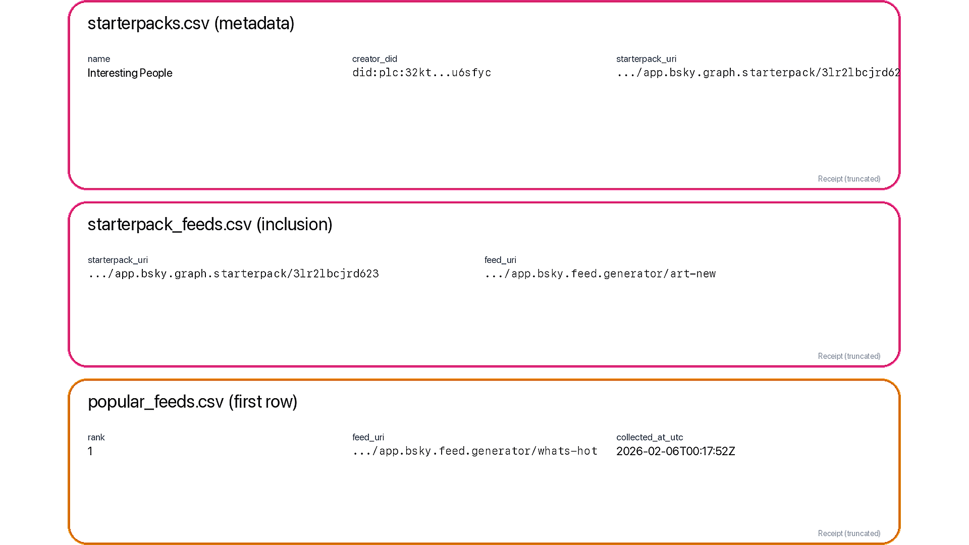
Data receipt: discovery surfaces (starter packs + popular list)
Takeaway: discovery is measurable via starter-pack inclusion and popular list ranks.
A. Starter packs
A
starterpacks + starterpack_feeds
B. Inclusion_count
B
slot_count (position-weighted)
C. Popularity_rank
Why it matters
C
Concentration + provider leverage
FEB 2026

Slide 27
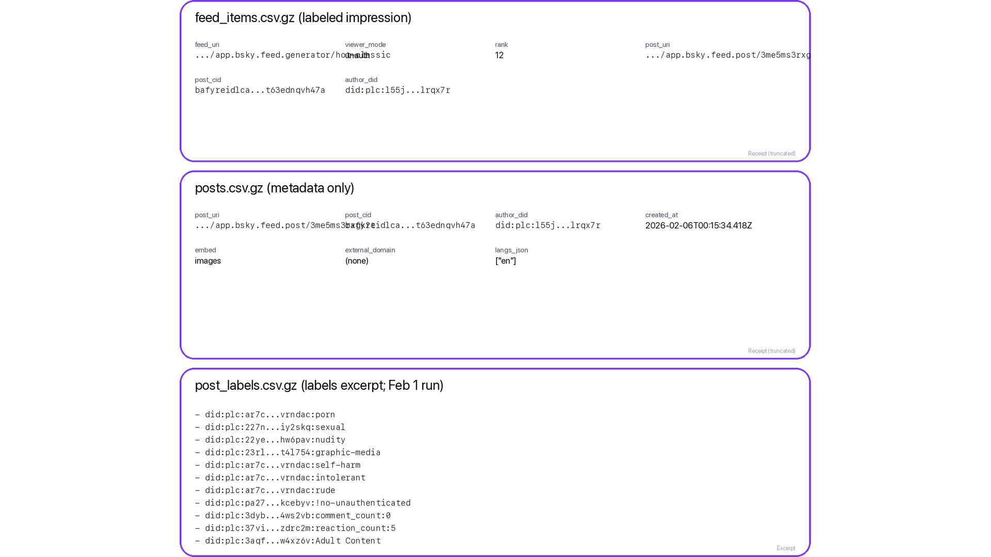
Data receipt: ranked exposure + risk labels
A. feed_items row
A
(feed_uri, viewer_mode, rank)
B. posts row
B
text + links + langs
C. post_labels row
C
H6: risk exposure
Feed auditing / mitigations

Slide 28
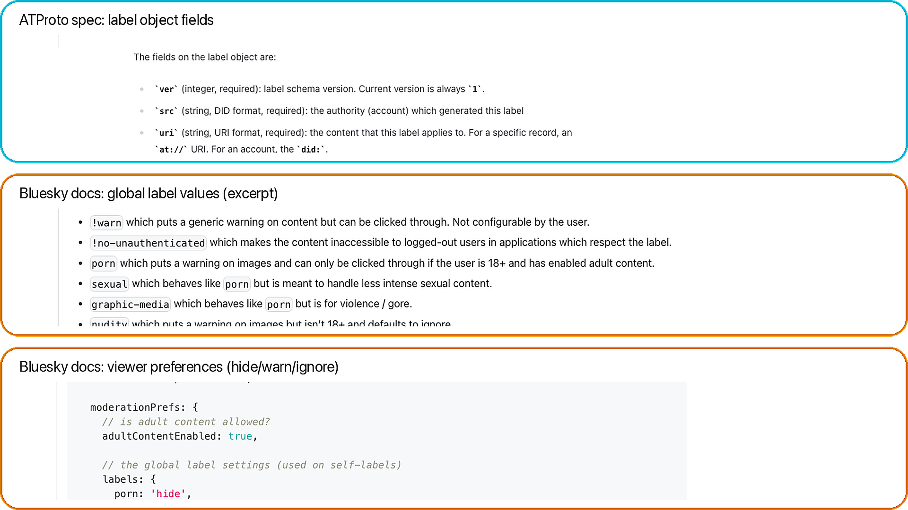
Data receipt: labels (schema + global values + prefs)
Takeaway: labels are structured safety signals; behavior depends on viewer prefs.
A. Label schema
A
(src, uri/cid, val, neg, cts)
B. Global values
B
protocol-defined strings
C. Viewer prefs
hide / warn / ignore
C
Docs grounding

Slide 29
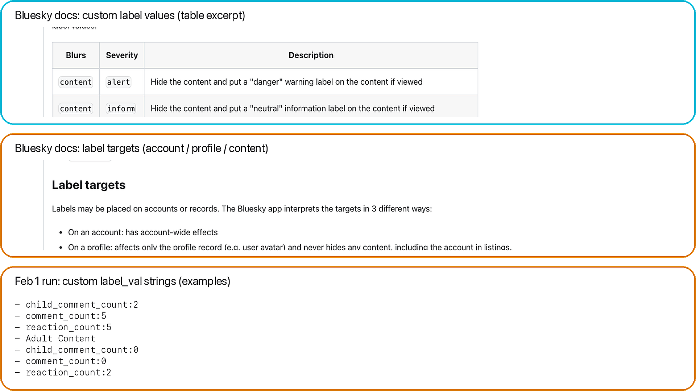
Data receipt: custom labels (definitions + targets)
Takeaway: labelers can define custom taxonomies; we preserve raw label_val strings.
A. Custom definitions
A
blur + severity + defaults
B. Label targets
B
account vs profile vs content
C. Observed values
dataset examples
C
Why it matters
FEB 2026

Slide 30
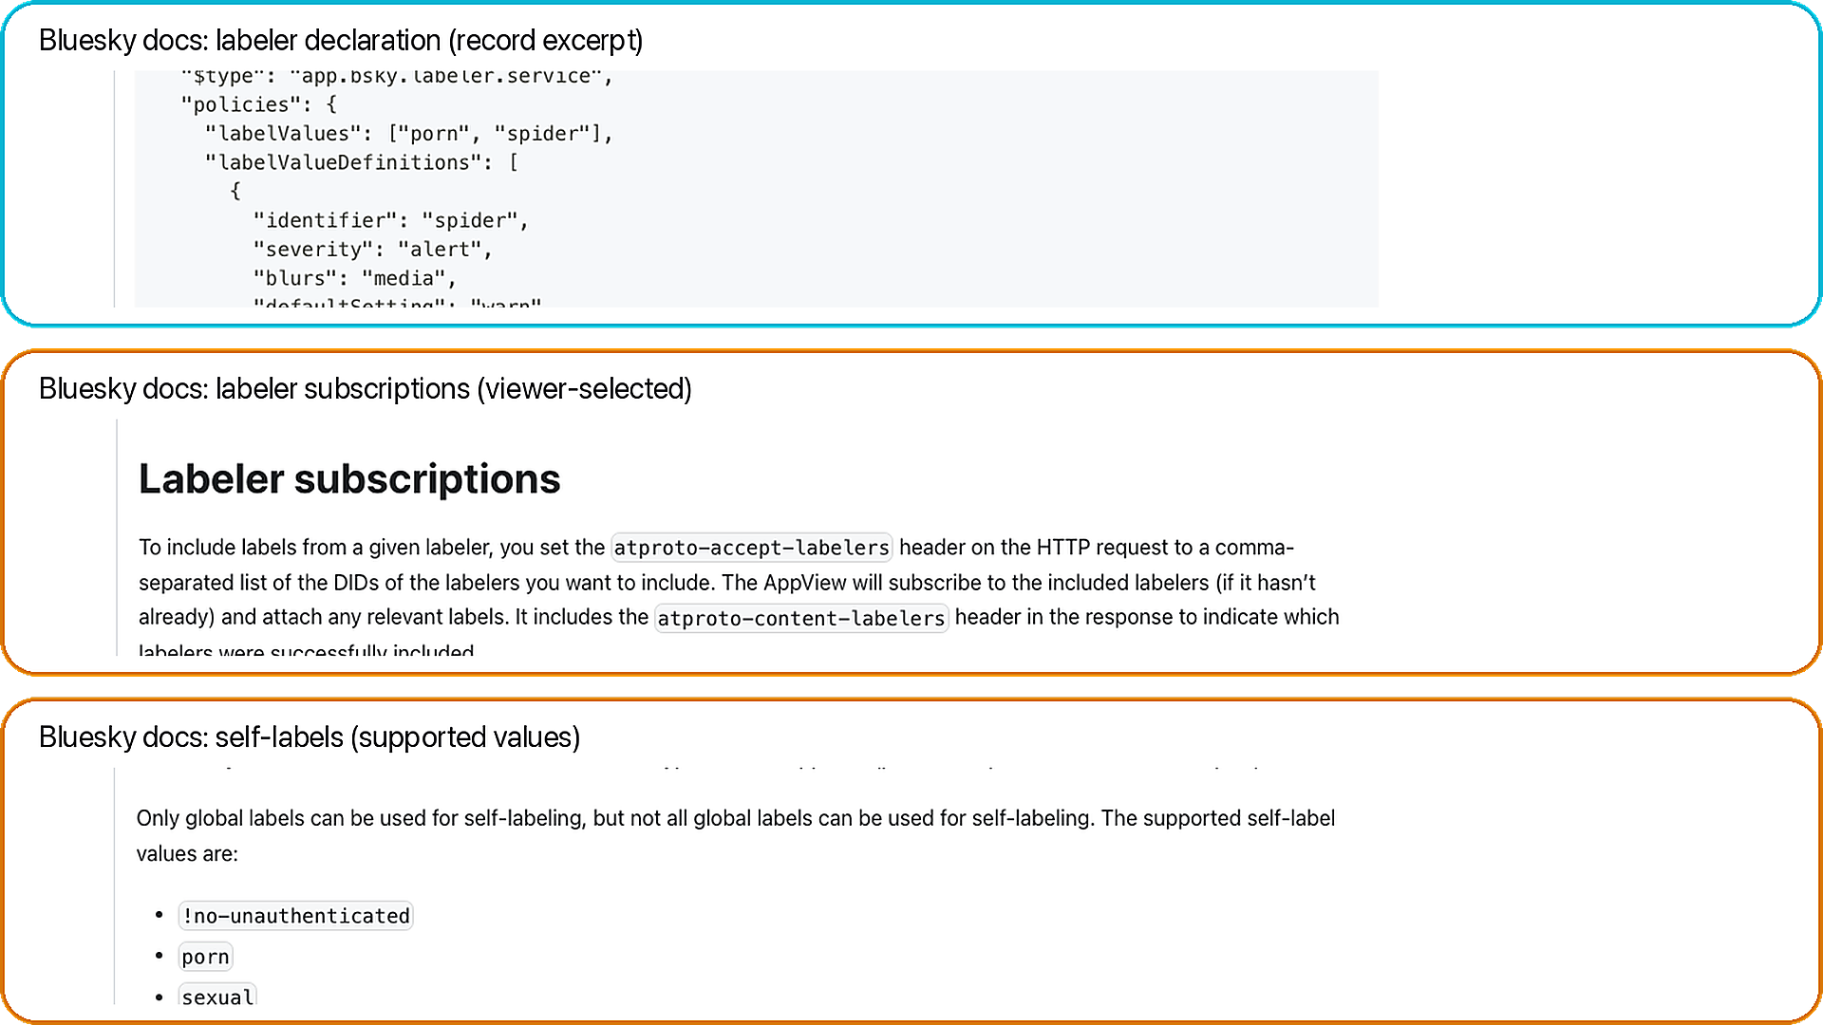
Data receipt: labelers (declarations + subscriptions + self-labels)
Takeaway: labels come from services; viewers choose which labelers to trust.
A. Declaration
A
values + policies
B. Subscriptions
B
viewer-selected
C. Self-labels
built-in values
C
Why it matters
FEB 2026

Slide 31
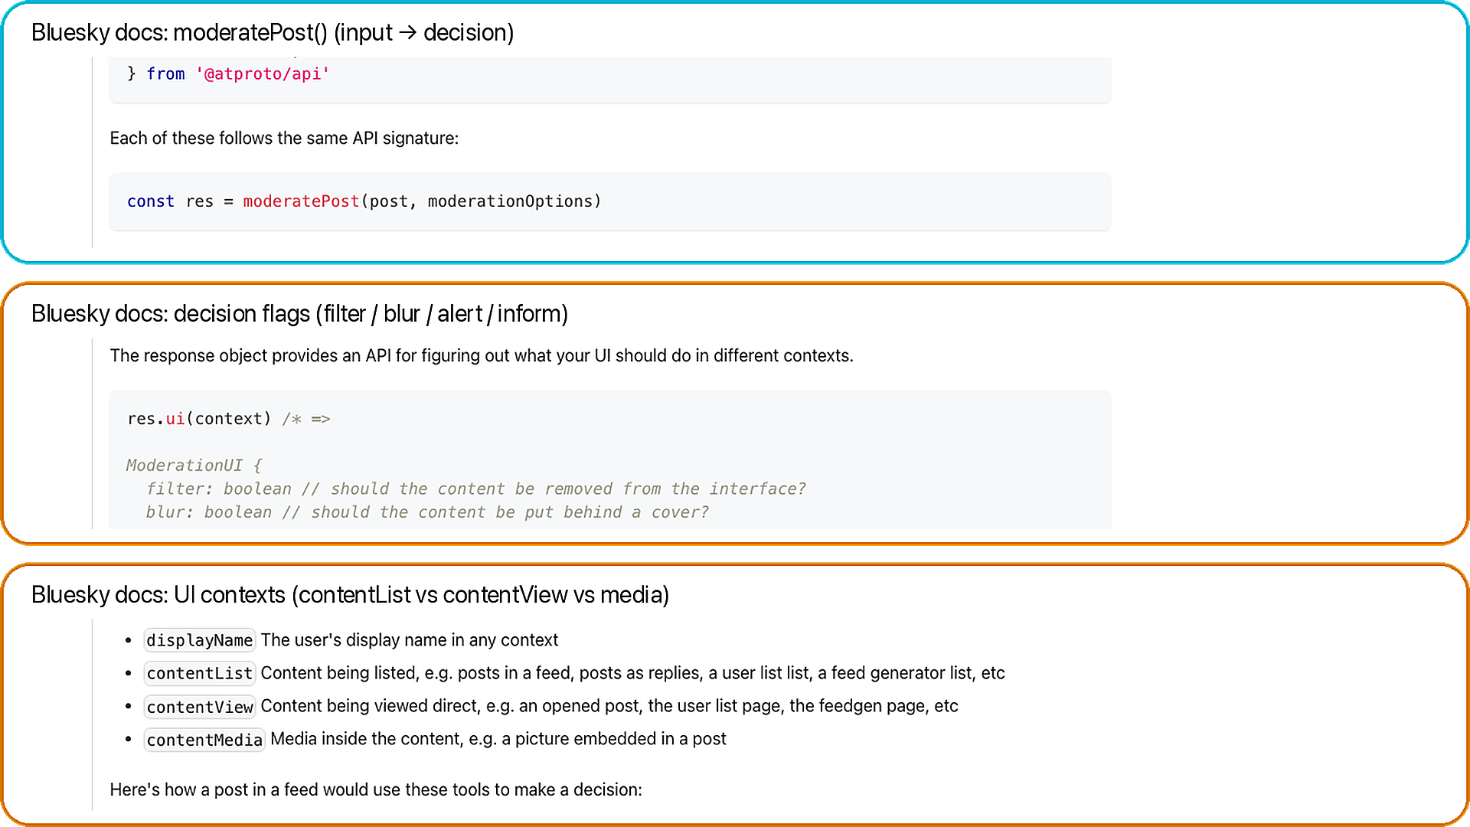
Data receipt: moderation decisions (flags + UI contexts)
Takeaway: the same label can blur/warn/filter depending on context + prefs.
A. moderatePost()
A
post + prefs → decision
B. Output flags
B
filter / blur / alert / inform
C. UI contexts
contentList vs view vs media
C
Docs grounding
FEB 2026

Slide 32
Collection credibility (one slide)
Read-only XRPC summary
• Relay + AppView reads.
• GET-only in this run.
• POST auth only if auth mode is used.
• No posting actions.
7-stage pipeline
• relay -> index -> packs -> popular -> enrich -> panel -> snapshot
• Reproducibility: state.db, manifest.csv, data_dictionary.csv, validation_report.csv.
FEB 2026

Slide 33
What this enables next + advisor asks
Ready measurements
• RQ1: measure discovery concentration.
• RQ2: map provider leverage.
• RQ3: test same winner overlap.
• RQ4: compare label variability.
What I need from you
• Ask 1: priority RQs and venue fit.
• Ask 2: recollect longitudinal, auth mode, or experiments?
FEB 2026

Slide 34
Appendix: official Bluesky UI screens
BLUESKY RQs + DATA
FEB 2026

